Slide 1
Detecting Abusive Comments in INdian Languages
JYOTHIKA UDUGULA
08/25/2025

Slide 2
Abstract
India is home to 22 official languages, 122 major languages, and over 1,599 additional languages, making it one of the most linguistically diverse countries in the world. As social media platforms like Twitter, Facebook, and Instagram expand, abusive content has increased significantly. However, many existing moderation tools offer limited support for Indian languages, allowing harmful, abusive posts to spread easily (Badjatiya et al., 2017; Kakwani et al., 2020). This project focuses specifically on detecting abusive and non-abusive comments in Hindi, one of India’s most widely used languages on social media. Using a Hindi dataset from Kaggle, this project applies natural language processing (NLP) techniques to classify comments as abusive or non-abusive. For this project, only the Hindi language is analyzed. The study evaluates and compares several machine learning models to classify comments as abusive or non-abusive. The results demonstrate that NLP can effectively classify abusive Hindi comments and can support safer online environments. Future work may extend this approach to additional Indian languages.

Slide 3
Overarching Question: Can a machine learning model effectively detect abusive comments in Hindi?
Of the two models studied, which model worked best for detecting abusive Hindi comments?
What challenges occur when detecting abusive language in Hindi?
Research Questions

Slide 4
Description of Project
Social media platforms in India include comments written in many languages and dialects, making abusive content detection difficult.
This project focuses on Hindi, chosen because it is widely used and has a large presence on social media.
The goal is to develop an NLP-based model that classifies Hindi comments as abusive or non-abusive.

Slide 5
Description of Customer/User Benefits
This project benefits organizations and platforms that manage large volumes of online content, like social media sites, forums, and news websites.
These platforms often face challenges in detecting abusive comments in Hindi due to informal writing, slang, and spelling variations.
By developing an NLP model specifically for Hindi, the project improves the accuracy of detecting and managing abusive Hindi comments.
With the ability to detect abusive Hindi content in real time, online spaces can become safer, and organizations can respond more effectively.

Slide 6
Understanding the Data
Data set: The data for this project was taken from Kaggle, a popular website where people share data sets and participate in data science challenges. This data set was chosen because it fits the project’s needs.
Explanation of each column:
language → Used in analysis: Tells which language the comment is written in (like Hindi).
post_index → Used in analysis: A number that shows which post the comment belongs to.
commentText → Used in analysis: The actual words of the comment.
report_count_comment → Not used in analysis: How many times people reported this comment. does not reliably indicate whether it is abusive.
report_count_post → Not used in analysis: How many times people reported this comment does not reliably indicate whether it is abusive.

Slide 7
report_count_post → Not used in analysis: How many times people reported the post itself.
like_count → Not used in analysis: Number of likes a comment received (used only as a supporting feature; the model does not rely on this variable).
Note: like_count is used only as an auxiliary feature. Since new comments may not yet have likes, the model does not rely on this feature alone for classification.
label → Used in analysis: Marks if the comment is non-abusive (0) or abusive (1).
Note: Target Variable: label (0 = Non-Abusive, 1 = Abusive).
Source: Kaggle Dataset–Abusive Comments in Indian Languages, 2023.

Slide 8
How Abusive vs. Non-Abusive Labels Were Determined
Multiple fluent Hindi speakers manually labeled the dataset, but only one person reviewed each comment.
Reviewers independently read each comment and assigned labels (0 = non-abusive, 1 = abusive).
Reviewers were not given formal instructions; they classified comments based on a common-sense understanding of abusive language.
Because labeling was done individually, the process may include subjective bias.
These manually assigned labels served as the ground truth for model training, validation, and testing.
8

Slide 9
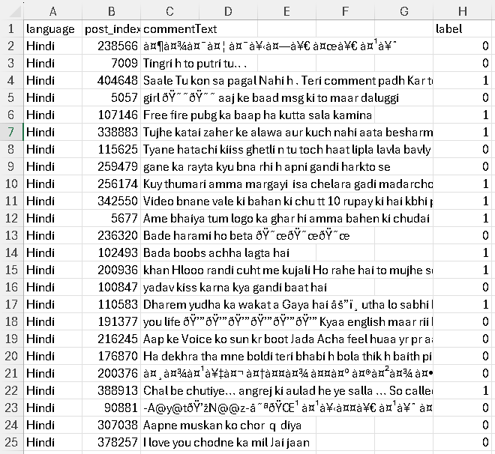
9

Slide 10
Understanding the Data: Example Data
Sample Variables:
Language: The language of the comment (example: Hindi).
Comment Text: The actual text of the comment.
Label: Indicates if the comment is abusive (1) or non-abusive (0).
Sample Observations:
Example 1: “Usko driving karni nahi aati”. (Hindi text) - Label: 1 (abusive)
English: “He doesn’t know how to drive.”
Example 2: "Yeh ek sundar post hai!" (Hindi text) - Label: 0 (non-abusive)
English: "This is a beautiful post!"
10

Slide 11
Tokens, Vectorization, TF-IDF (Term Frequency-Inverse Document Frequency), and Regex
Sample Variables Token: A unit of text (word, subword, or character). Tokens are the building blocks used for analysis.
Example: “driver”.
Vectorization: Converting text into numerical values.
Example: word counts or TF-IDF (Term Frequency-Inverse Document Frequency) values.
Sample Variables TF-IDF: Weights words by importance (rare = high value, common = low value). This helps highlight informative words.
Example: “terrible” in a set of reviews.
Regex (Regular Expression): A rule-based pattern used to match, search, or clean text.
Example: Removing special characters or finding all words with digits.
11

Slide 12
Understanding the Data: Data Cleaning
To improve model accuracy, noise such as unnecessary tokens was removed to ensure the model would use words from the comments for prediction.
Converted all text to lowercase to ensure uniformity.
URLs were removed using regex to eliminate web links.
Digits were removed to filter out irrelevant tokens.
Newlines were replaced with spaces, while extra spaces were collapsed and trimmed for a clean format.
Non-alphabetic characters were removed, including foreign characters (often from emoji encoding) and numbers/digits.
12

Slide 13
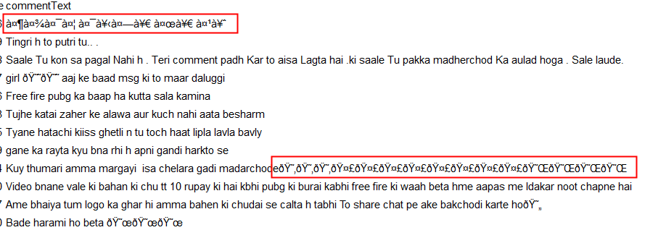
Understanding the Data: Data Cleaning
The text appears to include improperly/foreign characters, likely resulting from emoji encoding or foreign language character sets.
These characters may disrupt text processing or analysis due to their unexpected format.
To address this, a regex-based approach was used to identify and remove these unwanted characters, ensuring cleaner and more consistent data for analysis.
To support the cleaning and labeling process, the dataset was shared with fluent Hindi speakers for manual label classification to determine which comments were abusive or non-abusive.
13

Slide 14
Partition Table for Hindi
Partition | Abusive | Non-Abusive | Total | Percentage
Training | 4,328 (52.70%) | 3,884 (47.30%) | 8,212 | 60%
Validation | 1,803 (52.70%) | 1,618 (47.30%) | 3,421 | 25%
Testing | 1,082 (52.68%) | 972 (47.32%) | 2,054 | 15%
Totals | 7,213 (52.70%) | 6,474 (47.30%) | 13,687 | 100%
14

Slide 15
Data Preparation
TF-IDF (Term Frequency–Inverse Document Frequency): Converts raw text into a numerical format by weighting words according to importance.
Applied Only on Training Partition: TF-IDF vocabulary and weights were fitted using only the training data to avoid data leakage.
Transformation for Validation & Testing: Validation and test partitions were transformed using the vocabulary learned from training data.
Purpose: Enhances the model’s ability to distinguish between abusive and non-abusive comments.
15

Slide 16
Text Processing Workflow — Tokenization
Text Tokenization Process: The model starts by converting raw text into numerical features using a CountVectorizer, which creates a matrix of word counts.
Word count: Word count refers to the total number of words used as features.
Dataset sample: The Hindi dataset was used for training and evaluating the model throughout the workflow.
Tokenization for Machine Learning Models: Text tokenization was used for both Naive Bayes models and Logistic regression since both models used TF-IDF-based features. Tokenization breaks each comment into individual words (tokens), which are then converted into numerical features for classification. Because TF-IDF requires tokenization, Logistic Regression also relies on tokenized text as its input.
Example of tokenization:
Hindi text: “यह फिल्म बहुत बोरिंग है।”
English translation: “This movie is very boring.”
Tokens : [“यह”, “फिल्म”, “बहुत”, “बोरिंग”, “है”]
English translation: [“This”, “movie”, “is”, “very”, “boring”]
16

Slide 17
Text Processing Workflow — TF-IDF & Classification Steps
Feature Weighting: After counting the words, the model uses TF-IDF to find which words are more important. Words that appear often in one text but not in others get higher importance scores.
The TF-IDF values are learned from the training data only, and the same values are then used on validation and test data to prevent data leakage.
Classification: Machine learning models (Naive Bayes and logistic regression) classifier is trained on the TF-IDF features to predict the target labels.
Pipeline Integration: The complete pipeline streamlines feature extraction and classification, enabling efficient predictions on new data.
17

Slide 18
Modeling Process
Converting Text into Numbers:
The comments are changed into numbers using a method called TF-IDF (Term Frequency-Inverse Document Frequency).
Why Using TF-IDF:
TF-IDF helps the model understand which words are important in a comment.
TF-IDF values were generated using the Training partition only to prevent data leakage.
Some words like "the", "is", or "you" appear in almost every sentence—they do not help find abuse. But words like "stupid" or "terrible" might only appear in abusive comments.
TF-IDF gives more importance to rare but meaningful words, and less importance to common words.
18

Slide 19
Simple Example:
Comment 1: "You are a terrible driver“.
Comment 2: "He is a good driver“.
Both have the word "driver", but only Comment 1 has "terrible", which signals abuse. (Kakwani et al., 2020). TF-IDF helps the model focus on "terrible"—the important word. (Kakwani et al., 2020).
“Terrible” is considered important due to its TF-IDF weight, not because it always signals abuse.
Examples in Hindi: - Hindi: “बुरा” (bad) - Hindi: “बहुत खराब” (very bad)
Note: The model currently analyzes each comment individually and does not handle context. Future versions could incorporate contextual understanding to detect sarcasm or subtle forms of abuse.
19

Slide 20
Source: Derived from project implementation and linguistic examples (Kakwani et al., 2020).
In this project:
TF-IDF changed text into numbers so the model could learn which words point to abusive behavior.
This made it better at finding abusive comments, even in different Indian languages.
This method gives each word in a comment a number based on its importance. Words that appear frequently in a comment but not in others receive higher numbers.
Training the Model: After changing the text into numbers, Naive Bayes & Logistic Regression models were used to learn from the data. The models, through complex calculations, try to classify comments into either an abusive or non-abusive comment category.
20

Slide 21
Checking How Well the Model Did: Once the model makes predictions, a confusion matrix is used to help determine how well the model predicts. This means the number of times the model makes an error, such as predicting abusive when it would be non-abusive.
21

Slide 22
Measuring the Model's Performance: From the confusion matrix, the following measures are calculated:
Accuracy: How often the model made the right prediction.
Sensitivity (Recall): How well the model identifies Abusive (1) comments.
Precision: How often the model was right when it said something was Abusive (1).
Specificity: How well the model detects Non-Abusive (0) comments.
F-1 Score: Balances precision and specificity to show overall prediction quality.
Matthews Correlation Coefficient (MCC): A single score showing how well predictions match actual labels, even with imbalanced data.
22

Slide 23
Naive Bayes Data Preparation
Reasons for Using Naive Bayes
Simplicity & Efficiency: Chosen for its simplicity in implementation and speed in processing text data.
Effective for Text Data: Well-suited for handling high-dimensional data typical of text classification tasks.
Performs Well with Limited Data: Works effectively when there is not a massive dataset, which is often the case for Hindi abusive comments.
23

Slide 24
Models: Naive Bayes Classifiers
MultinomialNB: Best for text classification and handling discrete data; chosen as the main classifier.
BernoulliNB: Ideal for binary features, focusing on the presence or absence of words.
ComplementNB: Tailored for imbalanced datasets, providing robustness in skewed distributions.
Note: GaussianNB is not used as it is optimized for continuous data with a normal distribution.
24

Slide 25
Models: Naive Bayes | Confusion Matrix |
Multinomial NB | Training
25

Slide 26
Models: Naive Bayes | Confusion Matrix |
Multinomial NB | Validation
Confusion Matrix Multinomial NB |Validation
Confusion Matrix Multinomial NB
Predicted
Partition
0 Not Abusive
1 Abusive
Total
Actual 0 (Not Abusive)
1045
573
1618
Actual 1 (Abusive)
227
1576
1803
Total
1272
2149
3421
Training Metrics
Training Metrics
Value
Accuracy (ACC)
0.7662 (76.62%)
Sensitivity (TPR/Recall)
0.8741 (87.41%)
Precision (PPV)
0.7334 (73.34%)
Specificity (SPC)
0.6459 (64.59%)
F1 Score
0.7976 (79.76%)
Matthews (MCC)
0.5371 (53.71%)
26

Slide 27
Models: Naive Bayes | Confusion Matrix |
Bernoulli NB | Training
27

Slide 28
Models: Naive Bayes | Confusion Matrix |
Bernoulli NB | Validation
Confusion Matrix Bernoulli NB |Validation
Confusion Matrix Bernoulli NB
Predicted
Partition
0 Not Abusive
1 Abusive
Total
Actual 0 (Not Abusive)
1011
607
1618
Actual 1 (Abusive)
221
1582
1803
Total
1232
2189
3421
Training Metrics
Training Metrics
Value
Accuracy (ACC)
0.7580 (75.80%)
Sensitivity (TPR/Recall)
0.8774 (87.74%)
Precision (PPV)
0.7227 (72.27%)
Specificity (SPC)
0.6248 (62.48%)
F1 Score
0.7926 (79.26%)
Matthews (MCC)
0.5224 (52.24%)
28

Slide 29
Models: Naive Bayes | Confusion Matrix |
Complement NB | Training
29

Slide 30
Models: Naive Bayes | Confusion Matrix |
Complement NB | Validation
30

Slide 31
Models: Comparing Naive Bayes Classifiers | Training
Note: Light orange indicates the highest number in each row.
Note: The training results, especially for Complement Naive Bayes with an accuracy of 0.9180, appear very strong. However, training performance alone does not show how well the model generalizes. The validation results on the next slide will help determine whether the model is overfitting.
31

Slide 32
Models: Comparing Naive Bayes Classifiers | Validation
Note: Light orange indicates the highest number in each row.
Note: Compared to the training results, the validation accuracy for Complement Naive Bayes drops from 0.9180 to 0.7857. This decline shows clear overfitting, meaning the model performs well on training data but less effectively on unseen validation data.
32

Slide 33
Models: Comparing NB Classifiers (Validation Data)
ComplementNB – Complement Naive Bayes achieved the best overall performance, recording the highest accuracy (78.57%), precision (77.18%), specificity (72.25%), and F1 score (80.56%). It also achieved an MCC score of 57.07%, indicating a strong correlation between predictions and true labels. This model most effectively detects abusive comments while minimizing the misclassification of non-abusive ones.
Note: Although each of the three Naive Bayes options had similar summary statistics, Complement NB achieved the highest values for all metrics except one.
MultinomialNB has balanced performance – Multinomial Naive Bayes performed consistently with a validation accuracy of 76.62% and sensitivity of 87.41%, showing strength in identifying abusive comments. However, its precision (73.34%) and specificity (64.59%) were lower, meaning it sometimes labeled non-abusive comments as abusive.
BernoulliNB – Bernoulli Naive Bayes produced results close to the other models but was weaker overall, showing the lowest accuracy (75.80%), precision (72.27%), and specificity (62.48%). Despite similar trends, its simpler binary approach made it less accurate for TF-IDF-based text data.
33

Slide 34
Conclusion – ComplementNB demonstrated the most reliable performance across all metrics, showing a strong balance between detecting abusive comments and correctly identifying non-abusive ones.
34

Slide 35
Models: Binary Logistic Regression
Reasons for Using Logistic Regression
Baseline for Interpretability & Linguistic Analysis – Logistic Regression allows identification of Hindi words or slang that are most influential in predicting abusive comments, providing transparency in how the model makes decisions.
Efficient for Limited Hindi Data – Because it works well even when it doesn’t have a lot of labeled examples, Logistic Regression is great for Hindi, where there isn’t much annotated abusive content available. Logistic Regression performs well with limited labeled data because it is a simple linear model that generalizes effectively in high-dimensional, sparse feature spaces such as TF-IDF.
Benchmark for Model Comparisons – It’s a simple starting point that can be used to compare with more advanced models later, like Transformers, to check if they improve results.
Logistic Regression is designed to handle problems with two choices, like deciding if a comment is abusive or not, which matches this project’s task perfectly.
35

Slide 36
Logistic Regression – Regularization in High-Dimensional Data
Logistic Regression contained 22,781 TF-IDF variables and 8,212 training observations. Because the number of predictors (P) is greater than the number of observations (n), the dataset is high-dimensional (p>n). This creates sparse, highly collinear data and increases the risk of overfitting.
L2 regularization (Ridge) was applied to control coefficient size and provide stability in this high-dimensional setting.
However, regularization does not fully solve issues caused by class imbalance; it mainly stabilizes coefficients.
The model used the default L2 strength = 1.0, which offered reliable convergence without overshrinking important linguistic patterns.
This default value is commonly recommended when no tuning information is available and provides a balanced starting point.
36

Slide 37
High dimensionality poses a challenge because the design matrix XᵀX becomes non-invertible when p > n.
Hastie et al. (2009) (Chapter 3, pages 47 – 48) describe that when predictors greatly exceed observations (p >> n), matrix inversion is mathematically impossible.
Sources:
Hastie, T., Tibshirani, R., & Friedman, J. (2009).
Ng, A. Y. (2004). Feature selection, L1 vs. L2 regularization.
37

Slide 38
Logistic Regression – High-Dimensional Input Summary
The TF-IDF vectorizer generated 22,781 independent variables (one for each unique word in the dataset).
TF-IDF vocabulary was fitted on the 8,212 training comments only.
The dataset contains 13,687 total comments, of which 8,212 comments were used for training.
Therefore, the model had a variables-to-observations ratio of 22,781 : 8,212, meaning p > n (high-dimensional setting).
High-dimensional TF-IDF data introduces challenges, such as:
Sparse and highly collinear features,
Increased risk of model overfitting,
Difficulty interpreting model diagnostics.
Source: Kakwani et al. (2020), Mujahid et al. (2024)
38

Slide 39
TF-IDF and Logistic Regression were trained only on the Training partition (8,212 comments), giving a predictor-to-observations ratio of 22,781 : 8,212 (p > n).
TF-IDF matrix is:
Very high-dimensional,
Extremely sparse,
Highly collinear.
These conditions cause the matrix XᵀX to be singular (non-invertible), which can be challenging.
39

Slide 40
Model interpretation used:
Regularization paths,
Coefficient magnitude tables,
Partition-based performance metrics (Training, Validation, Testing).
Regularization paths: show how coefficients shrink as the regularization penalty increases.
Coefficient magnitude tables: List the strongest positive and negative predictors after L2 regularization.
Model-building code with regularization is shown on Slides 91–100.
Sources:
Hastie, T., Tibshirani, R., & Friedman, J. (2009).
Ng, A. Y. (2004). Feature selection, L1 vs. L2 regularization.
40

Slide 41
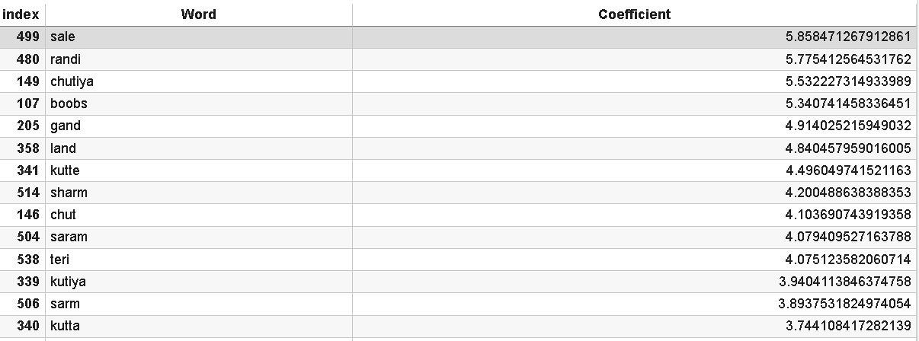
Logistic Regression – Top Predictive Features (Coefficients)
Logistic Regression assigns a weight (coefficient) to every TF-IDF token.
Larger positive coefficients correspond to tokens strongly associated with abusive comments.
Top Positive Coefficients (Abusive Predictors):
41

Slide 42
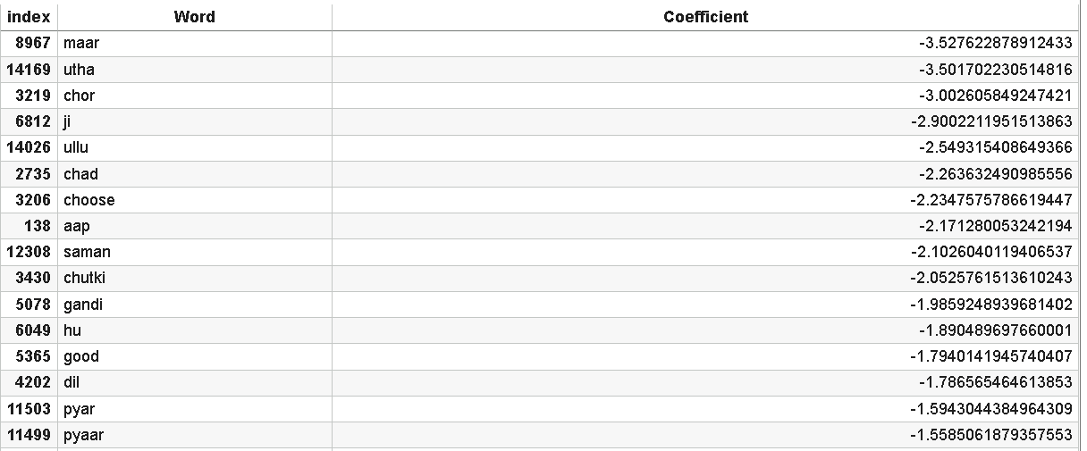
Larger negative coefficients correspond to tokens associated with non-abusive comments.
Top Negative Coefficients (Non-Abusive Predictors):
Out of the 22,781 TF-IDF predictor variables, 2,211 coefficients fall within the threshold range of –0.05 to +0.05. This leaves 20,570 variables with larger coefficients.
Therefore, the predictor-to-observation ratio remains extremely high at 20,570 : 8,212, confirming the high-dimensional p > n condition.
Note: Regularization shrank thousands of coefficients extremely close to zero, effectively performing variable selection.
42

Slide 43
Models: Binary Logistic Regression |
Confusion Matrix | Training
Confusion Matrix Binary Logistic Regression |Training
Confusion Matrix Binary Logistic Regression
Predicted
Partition
0 Not Abusive
1 Abusive
Total
Actual 0 (Not Abusive)
3575
309
3884
Actual 1 (Abusive)
490
3838
4328
Total
4065
4147
8212
Training Metrics
Training Metrics
Value
Accuracy (ACC)
0.9027 (90.27%)
Sensitivity (TPR/Recall)
0.8868 (88.68%)
Precision (PPV)
0.9255 (92.55%)
Specificity (SPC)
0.9204 (92.04%)
F1 Score
0.9057 (90.57%)
Matthews (MCC)
0.8061 (80.61%)
43

Slide 44
Models: Binary Logistic Regression |
Confusion Matrix | Validation
Confusion Matrix Binary Logistic Regression | Validation
Confusion Matrix Binary Logistic Regression
Predicted
Partition
0 Not Abusive
1 Abusive
Total
Actual 0 (Not Abusive)
1140
478
1618
Actual 1 (Abusive)
202
1601
1803
Total
1342
2079
3421
Training Metrics
Training Metrics
Value
Accuracy (ACC)
0.8012 (80.12%)
Sensitivity (TPR/Recall)
0.8880 (88.80%)
Precision (PPV)
0.7701 (77.01%)
Specificity (SPC)
0.7046 (70.46%)
F1 Score
0.8248 (82.48%)
Matthews (MCC)
0.6059 (60.59%)
44

Slide 45
Models: Logistic Regression – Evaluation Summary
Training: The model performed very well on the training data, with an accuracy of 90.27%, meaning it got most predictions right. Its sensitivity was 88.68%, indicating it was effective at detecting abusive comments. The precision was 92.55%, so when it flagged a comment as abusive, it was right most of the time. The specificity was 92.04%, meaning it also correctly identified non-abusive comments. The F1 score was 90.57%, showing a strong balance between precision and sensitivity, and the MCC was 80.61%, reflecting overall solid performance.
Validation: The model’s accuracy dropped to 80.12%, suggesting some overfitting. The sensitivity was 88.80%, so it still detected most abusive comments. The precision was 77.01%, showing it maintained good prediction quality, and specificity was 70.46%, indicating a fair ability to recognize non-abusive comments. The F1 score was 82.48%, showing a good balance between precision and sensitivity, and MCC was 60.59%, reflecting fair overall performance.
45

Slide 46
Models: Comparing Best NB & Logistic Regression
Note: The values highlighted in light orange represent the highest scores across each metric. All comparisons are based on the validation partition results for the models.
The results show that Logistic Regression slightly outperformed ComplementNB on the validation partition, especially in accuracy and sensitivity, while ComplementNB maintained stronger training results.
46

Slide 47
Model Comparison (Validation Data)
Accuracy: Logistic Regression (80.12%) is slightly better than Complement Naive Bayes (78.57%), meaning Logistic Regression makes correct predictions more often overall.
Sensitivity (Recall): Logistic Regression (88.80%) outperforms Complement Naive Bayes (84.25%), in identifying abusive comments.
Precision: Complement Naive Bayes (77.18%) performs slightly better than Logistic Regression (77.01%), indicating that Complement Naive Bayes is marginally better at avoiding non-abusive.
Specificity: Complement Naive Bayes (72.25%) performs better than Logistic Regression (70.46%), indicating that it more accurately identifies non-abusive comments.
F1 Score: Logistic Regression (82.48%) is higher than Complement Naive Bayes (80.56%), showing Logistic Regression is a better balance between precision and sensitivity.
47

Slide 48
Matthews Correlation Coefficient (MCC): Logistic Regression (60.59%) is higher than Complement Naive Bayes (57.07%), indicating that Logistic Regression has stronger overall performance when handling imbalanced data.
Conclusion: Logistic Regression proved to be more dependable. While the overall differences between the two models are not very large, Logistic Regression showed slightly better and more consistent performance on the validation data, particularly in accuracy, specificity, F1 score, and MCC. Complement Naive Bayes achieved higher precision and was more effective at identifying non-abusive comments, but its performance dropped more between training and validation. Overall, Logistic Regression provides steadier results across the evaluation metrics, whereas Complement Naive Bayes is preferable when precision and reducing false positives are the main priorities.
48

Slide 49
Models: Binary Logistic Regression |
Confusion Matrix | Testing
49

Slide 50
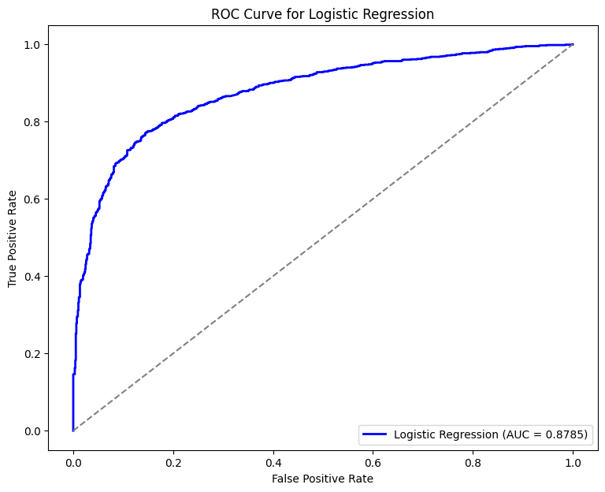
Models: Interpretation
Note: The ROC curve for Logistic Regression using the testing partition shows strong separability between abusive and non-abusive Hindi comments, with an AUC of 0.8785, indicating strong model performance.
50

Slide 51
Models: Interpretation ROC Summary
The ROC Curve (Receiver Operating Characteristic) shows the trade-off between sensitivity (True Positive Rate) and 1 - specificity (False Positive Rate) at different classification thresholds. The blue line represents the actual performance of the Logistic Regression model—it shows how well the model separates abusive comments (positives) from non-abusive comments (negatives). The dotted gray diagonal line represents random guessing. The farther the blue line is above this diagonal, the better the model’s ability to distinguish between the two classes.
Logistic Regression achieved an AUC (Area Under the Curve) of 0.8785, which indicates strong model performance.
51

Slide 52
Conclusions
Logistic Regression proved to be the most dependable model for detecting abusive Hindi comments. It consistently performed better than Complement Naive Bayes in terms of accuracy, sensitivity, F1 score, and MCC. The model showed strong and steady performance throughout all testing stages, reaching 90.27% accuracy and a 90.57% F1 score on the training data, 80.12% accuracy and 82.48% F1 score on the validation data, and 84.47% accuracy, 84.40% precision, and 85.44% F1 score on the testing data. These results demonstrate that the model can effectively handle new, unseen Hindi data while maintaining a good balance between precision and sensitivity.
Although Complement Naive Bayes also performed well and showed slightly higher precision and specificity, Logistic Regression proved to be more consistent and reliable overall. It performed strongly across different Hindi datasets, meaning it worked well on data in all three partitions. This makes Logistic Regression the better choice for detecting abusive comments in Hindi. The TF-IDF feature space had 22,781 variables but only 13,687 observations, making the data sparse and increasing collinearity and model complexity. Despite this, proper preprocessing—such as text cleaning and TF-IDF—combined with tuning (regularization) allowed even simple machine-learning models to achieve strong performance.
52

Slide 53
Challenges and Difficulties Encountered
Handling Hindi Text Variations: Working with Hindi text was challenging because people use different spellings, slang, and writing styles online. Cleaning and preparing the text properly was very important so the model could understand it correctly (Kakwani, et al., n.d.).
Class Distribution: The dataset had a slightly uneven distribution (7,213 abusive vs. 6,474 non-abusive comments), but the imbalance was small and did not create major difficulty. The imbalance came from the dataset itself—not from focusing only on Hindi.
Missing Target Labels: The original dataset did not include abusive/non-abusive labels. All labels had to be created manually, which introduced subjectivity and made the labeling process a major challenge.
Model Overfitting: Overfitting was reduced through L2 regularization, which shrinks large coefficients, and TF-IDF vocabulary control, which removes extremely rare noise words. These steps helped the model generalize better to unseen data.
53

Slide 54
Limitations
Language Diversity: Performance may vary even within Hindi due to differences in dialects, spelling styles, and data limitations.
Dialects & Slang: Regional words and slang can confuse the model, reducing accuracy.
Context Sensitivity: The model may misinterpret subtle or sarcastic forms of abuse.
No Specific Lexicon: The analyses did not use any domain-specific abusive-language lexicon; the presence of which might have improved detection accuracy.
Limited Model Scope: Only two models—Complement Naive Bayes and Logistic Regression—were evaluated, leaving other potential approaches unexplored.
Outdated Vocabulary: Fixed vocabulary may miss new slang or evolving terms.
54

Slide 55
Resource Intensive: Processing large text datasets in Hindi required significant computational power, which limited experimentation with additional models.
Labeling Subjectivity: The abusive/non-abusive labels were assigned manually, which may introduce inconsistency or bias without a multi-reviewer verification process.
55

Slide 56
Future Work (Next Steps)
Expand to Multiple Languages: In the future, the model can be extended to include additional Indian languages and dialects so it can detect abusive comments across a wider audience.
Collect more data: A bigger and more balanced dataset will help the model learn better and make more accurate predictions.
Use Smarter Models: Advanced models like BERT or MuRIL can be used to understand context, tone, and hidden meanings more effectively.
Test in Real Life: The model can be tested on real social media data to see how it performs in real-world situations.
Keep Improving: A feedback system can be added so users can report wrong results; this feedback can then be used to retrain and improve the model over time.
Closing Line: The above steps would build on the current project and can help create a stronger, smarter, and more reliable system for detecting abusive comments in Indian languages.
56

Slide 57
Improving Label Verification: Introduce a label verification mechanism where each comment is reviewed by multiple independent individuals, using agreement or voting methods to safeguard labeling accuracy.
57

Slide 58
Research Answers
Overarching Question: Can a machine learning model effectively detect abusive comments in Hindi?
Yes. A Logistic Regression model with TF-IDF feature extraction was developed to identify abusive comments. The model achieved strong accuracy and balance between precision and sensitivity, demonstrating that even a simple, well-tuned model can effectively detect abusive content in Hindi. However, further work is needed to improve the understanding of context, tone, and sarcasm to handle more complex cases.
Of the two models studied, which model worked best for detecting abusive Hindi comments?
Logistic Regression outperformed Complement Naive Bayes by achieving higher accuracy and F1 scores. This indicates that Logistic Regression offers more reliable and consistent results for detecting abusive Hindi comments.
58

Slide 59
What challenges occur when detecting abusive language in Hindi?
Hindi includes diverse slang, spelling variations, and informal expressions that differ across regions. These variations increase the difficulty of accurately identifying abusive comments. The model may occasionally misclassify or overlook abusive content due to these linguistic differences.
59

Slide 60
References
Kaggle. (2023). Multilingual Abusive Comment Classification [Data set].Kaggle.https://www.kaggle.com/competitions/multilingualabusivecomment/data
Badjatiya, P., Gupta, S., Gupta, M., & Varma, V. (2017). Deep Learning for Hate Speech Detection in Tweets. Proceedings of WWW ’17 Companion. https://doi.org/10.1145/3041021.3054223
Kakwani, D., Kunchukuttan, A., Golla, S., et al. (2020). IndicNLPSuite: Monolingual Corpora, Evaluation Benchmarks and Pre-trained Multilingual Language Models for Indian Languages. ACL. https://doi.org/10.18653/v1/2020.findings-emnlp.445
Khanuja, S., Bansal, D., Mehtani, S., et al. (2021). MuRIL: Multilingual Representations for Indian Languages. arXiv. https://doi.org/10.48550/arXiv.2103.10730
Mujahid, M., Kına, E., Rustam, F., et al. (2024). Data Oversampling and Imbalanced Datasets. Journal of Big Data, 11(1), 1–32. https://doi.org/10.1186/s40537-024-00943-4
60

Slide 61
Paul, C., & Bora, P. (2021). Detecting Hate Speech using Deep Learning Techniques. IJACSA, 12(2). https://doi.org/10.14569/ijacsa.2021.0120278
Lydia, E., Shankar, K., Nguyen, P., & Abadi, S. (2019). Logistic Regression for Health Profiling. IJEAT. https://doi.org/10.35940/ijeat.f1294.0886s219
IBM. (2021). Naive Bayes. IBM. https://www.ibm.com/think/topics/naive-bayes
Ng, A. Y. (2004). Feature selection, L1 vs. L2 regularization, and rotational invariance. Proceedings of the Twenty-First International Conference on Machine Learning, 78–85. https://doi.org/10.1145/1015330.1015435
Hastie, T., Tibshirani, R., & Friedman, J. (2009). The elements of statistical learning: Data mining, inference, and prediction (2nd ed.). Springer. https://hastie.su.domains/ElemStatLearn/
Manning, C. D., Raghavan, P., & Schütze, H. (2008). Introduction to information retrieval. Cambridge University Press. https://nlp.stanford.edu/IR-book/
61

Slide 62
THANK YOU
62

Slide 63
Appendix of Python Code
Imports
Installing Indic NLP library
!pip install indic-nlp-library
# Importing required libraries
import pandas as pd
import numpy as np
import re
import string
import collections
import matplotlib.pyplot as plt
from pathlib import Path
from sklearn.linear_model import LogisticRegression
from sklearn.feature_extraction.text import TfidfVectorizer
from sklearn.model_selection import train_test_split
from sklearn.metrics import classification_report, accuracy_score
63

Slide 64
from indicnlp.tokenize import indic_tokenize
from sklearn.model_selection import train_test_split
from sklearn.tree import DecisionTreeClassifier
from nltk.corpus import stopwords
from tensorflow.keras.preprocessing.text import Tokenizer
from tensorflow.keras.utils import pad_sequences, to_categorical
from tensorflow.keras import models, layers
from sklearn.preprocessing import LabelEncoder
from keras import models
from keras import layers
from colorama import Fore, Back, Style
NLP library​
!pip install indic-nlp-library Installing Indic NLP library​
64

Slide 65
Data Loading
from google.colab import drive
drive.mount('/content/drive')
file_path = '/content/drive/MyDrive/Colab Notebooks/CAPSTONE_PROJECT/Hindi.xlsx'
df = pd.read_excel(file_path)
# If Using Jupyter Notebook
# df = pd.read_excel("hindi.xlsx")
df.head()
65

Slide 66
Step 1: Initial Split
60% for training (used to train the model).
40% for further splitting (to be used for validation and final testing).
At this stage, the distribution is:
Training Set: 60 %
Test + Validation Set: 40 %
Step 2: Creating Validation and Test Sets
62.5% for validation (to fine-tune the model before final testing).
37.5% for testing (to evaluate model performance after training).
Now, the distribution becomes:
Validation Set: 25 %
Test Set: 15 %
Final Data Allocation
66

Slide 67
Final Data Allocation
Data Splitting : Training, Valuation & Testing Sets
Set | Samples
Training | 60 %
Validation | 25 %
Test | 15 %
67

Slide 68
Table Partition
X = df['commentText']
y = df['abusive']
# X_train, X_test, y_train, y_test = train_test_split(X, y, test_size = 0.3, random_state = 20)# split X and y into training and testing sets
X_train, X_temp, y_train, y_temp = train_test_split(X, y, test_size=0.4, random_state=542, stratify=y)# Initial Split (60% Training, 40% Temp)
# Splitting Temp Set into Validation (25%) and Test (15%)
X_val, X_test, y_val, y_test = train_test_split(X_temp, y_temp, test_size=0.375, random_state=73, stratify=y_temp) # 37.5% of 40% = 15%
print(f"Training Set: {X_train.shape[0]} samples")
print(f"Validation Set: {X_val.shape[0]} samples")
print(f"Test Set: {X_test.shape[0]} samples")
68

Slide 69
# Splitting Data
X = df['commentText']
y = df['abusive']
# Initial Split (60% Training, 40% Temp)
X_train, X_temp, y_train, y_temp = train_test_split(X, y, test_size=0.4, random_state=542, stratify=y)
# Splitting Temp Set into Validation (25%) and Test (15%)
X_val, X_test, y_val, y_test = train_test_split(X_temp, y_temp, test_size=0.375, random_state=73, stratify=y_temp) # 37.5% of 40% = 15%
69

Slide 70
# Creating Summary Table
def create_summary_table():
partitions = ["Training", "Validation", "Testing"]
abusive_counts = [y_train.sum(), y_val.sum(), y_test.sum()]
non_abusive_counts = [len(y_train) - y_train.sum(), len(y_val) - y_val.sum(), len(y_test) - y_test.sum()]
total_counts = [len(y_train), len(y_val), len(y_test)]
percentages = [60, 25, 15]
df_summary = pd.DataFrame({
"Partition": partitions,
"Abusive": [f"{abusive_counts[i]} ({abusive_counts[i] / total_counts[i] * 100:.2f}%)" for i in range(3)],
"Non-Abusive": [f"{non_abusive_counts[i]} ({non_abusive_counts[i] / total_counts[i] * 100:.2f}%)" for i in range(3)],
"Total": total_counts,
"Percentage": percentages
70

Slide 71
})
# Adding Total Row
total_abusive = sum(abusive_counts)
total_non_abusive = sum(non_abusive_counts)
total_total = sum(total_counts)
df_summary.loc[3] = ["Totals", f"{total_abusive} ({total_abusive / total_total * 100:.1f}%)",
f"{total_non_abusive} ({total_non_abusive / total_total * 100:.1f}%)", total_total, 100.00]
return df_summary
# Generate Summary Table
df_summary = create_summary_table()
71

Slide 72
# Plot Table
fig, ax = plt.subplots(figsize=(8, 2))
ax.set_title("Hindi Message Type by Partition")
ax.axis("tight")
ax.axis("off")
table = ax.table(cellText=df_summary.values, colLabels=df_summary.columns, cellLoc='center', loc='center',
colColours=["lightgrey"] * len(df_summary.columns))
table.auto_set_font_size(False)
table.set_fontsize(10)
table.auto_set_column_width([0, 1, 2, 3, 4])
plt.show()
72

Slide 73
Comparing the Naive Bayes Models
def confusion_matrix_plot(model, X_train, y_train, X_val, y_val, model_name):
fig, axes = plt.subplots(2, 1, figsize=(6, 6)) # Stack vertically for better readability
datasets = [(X_train, y_train, "Training"), (X_val, y_val, "Validation")]
for ax, (X, y, dataset_name) in zip(axes, datasets):
y_pred = model.predict(X)
cm = confusion_matrix(y, y_pred)
if cm.shape != (2, 2):
raise ValueError("This function is designed for binary classification problems.")
73

Slide 74
cm_with_totals = np.zeros((3, 3), dtype=int)
cm_with_totals[:2, :2] = cm
cm_with_totals[2, :2] = cm.sum(axis=0)
cm_with_totals[:2, 2] = cm.sum(axis=1)
cm_with_totals[2, 2] = cm.sum()
tn, fp, fn, tp = cm.ravel()
accuracy = (tp + tn) / cm.sum()
sensitivity = tp / (tp + fn)
specificity = tn / (tn + fp)
precision = tp / (tp + fp) if (tp + fp) != 0 else 0
f1 = 2 * (precision * sensitivity) / (precision + sensitivity) if (precision + sensitivity) != 0 else 0
74

Slide 75
# colors
colors = [
["#E3F2FD", "#FFCDD2", "#E0E0E0"],
["#FFCDD2", "#E3F2FD", "#E0E0E0"],
["#E0E0E0", "#E0E0E0", "#EEEEEE"],
]
for i in range(3):
for j in range(3):
ax.text(j + 0.5, i + 0.5, cm_with_totals[i, j], va="center", ha="center", fontsize=9)
# ax.add_patch(plt.Rectangle((j, i), 1, 1, color=colors[i][j], fill=True))
ax.add_patch(plt.Rectangle((j, i), 1, 1, color="#FFFFFF", fill=True))
for i in range(4):
ax.plot([i, i], [0, 3], color="black", linewidth=0.1)
ax.plot([0, 3], [i, i], color="black", linewidth=0.1)
75

Slide 76
ax.set_xlabel("Predicted", fontsize=10)
ax.set_ylabel("Actual", fontsize=10)
ax.set_xticks([0.5, 1.5, 2.5])
ax.set_yticks([0.5, 1.5, 2.5])
ax.set_xticklabels(["Not Abusive", "Abusive", "Total"], fontsize=9)
ax.set_yticklabels(["Not Abusive", "Abusive", "Total"], fontsize=9)
ax.set_xlim(0, 3)
ax.set_ylim(0, 3)
ax.invert_yaxis()
for spine in ax.spines.values():
spine.set_edgecolor("#dedede")
text_x = 3.5
ax.text(text_x, 0.5, f"Accuracy: {accuracy:.4f} ({accuracy * 100:.2f}%)", fontsize=9)
ax.text(text_x, 1.1, f"Sensitivity: {sensitivity:.4f} ({sensitivity *
76

Slide 77
100:.2f}%)", fontsize=9)
ax.text(text_x, 1.7, f"Precision: {precision:.4f} ({precision * 100:.2f}%)", fontsize=9)
ax.text(text_x, 2.3, f"Specificity: {specificity:.4f} ({specificity * 100:.2f}%)", fontsize=9)
ax.set_title(f"{dataset_name} Set", fontsize=12)
fig.suptitle(f"Confusion Matrices ({model_name})", fontsize=14)
fig.tight_layout()
plt.subplots_adjust(hspace=0.5) # Increase vertical spacing
plt.subplots_adjust(left=0.1, right=0.9, top=0.9, bottom=0.1)
# fig.patch.set_linewidth(0.5)
# fig.patch.set_edgecolor("#dedede")
plt.show()
77

Slide 78
def naive_bayes_types(X, y):
models = {
"MultinomialNB": MultinomialNB(),
"BernoulliNB": BernoulliNB(),
"ComplementNB": ComplementNB()
}
trained_models = {} # Dictionary to store trained models
for name, model in models.items():
# Pipeline for models
nb_pipeline = Pipeline([
('vect', CountVectorizer()),
('tfidf', TfidfTransformer()),
('clf', model) ])
nb_pipeline.fit(X_train, y_train) # Train model
78

Slide 79
trained_models[name] = nb_pipeline # Store trained mode
return trained_models # Return trained models
# Call function and store trained models
models = naive_bayes_types(X, y)
# Apply to each model
for model_name, model in models.items():
confusion_matrix_plot(model, X_train, y_train, X_val, y_val, model_name)
79

Slide 80
def compute_metrics(model, X_train, y_train, X_val, y_val):
metrics = {}
# Define a helper function to compute metrics from predictions
def calc_metrics(y_true, y_pred):
acc = accuracy_score(y_true, y_pred)
cm = confusion_matrix(y_true, y_pred)
# Ensure the confusion matrix is in a binary format
if cm.shape == (2, 2):
tn, fp, fn, tp = cm.ravel()
sensitivity = tp / (tp + fn) if (tp + fn) > 0 else 0 # Recall
specificity = tn / (tn + fp) if (tn + fp) > 0 else 0
precision = tp / (tp + fp) if (tp + fp) > 0 else 0
else:
# Fallback values for non-binary classification or edge cases
sensitivity = specificity = precision = 0
80

Slide 81
return {
"Accuracy": acc,
"Sensitivity": sensitivity,
"Precision": precision,
"Specificity": specificity
}
# Compute metrics on training data
y_train_pred = model.predict(X_train)
train_metrics = calc_metrics(y_train, y_train_pred)
# Compute metrics on validation data
y_val_pred = model.predict(X_val)
val_metrics = calc_metrics(y_val, y_val_pred)
metrics["Train"] = train_metrics
metrics["Validation"] = val_metrics
return metrics
81

Slide 82
def generate_nb_metrics_table(X_train, y_train, X_val, y_val):
# Train Naive Bayes models using the custom function
models = naive_bayes_types(X_train, y_train)
# Compute metrics for each model using a custom compute_metrics function
metrics_data = {}
for model_name, model in models.items():
# compute_metrics should return a dict with keys "Train" and "Validation"
metrics_data[model_name] = compute_metrics(model, X_train, y_train, X_val, y_val)
82

Slide 83
# Create a multi-index for column headers (Model and Dataset)
multi_index = pd.MultiIndex.from_product(
[list(models.keys()), ["Training", "Validation"]],
names=["Model", "Dataset"]
)
# Build the structured DataFrame for the metrics table
metrics_df = pd.DataFrame(
{
(model, dataset): metrics_data[model][dataset]
for model in models
for dataset in ["Train", "Validation"]
},
index=["Accuracy", "Sensitivity", "Precision", "Specificity"]
)
metrics_df.columns = multi_index # Apply the multi-level column header
83

Slide 84
(model, dataset): metrics_data[model][dataset]
for model in models
for dataset in ["Train", "Validation"]
},
index=["Accuracy", "Sensitivity", "Precision", "Specificity"]
)
metrics_df.columns = multi_index # Apply the multi-level column header
# Plot the table using matplotlib
fig, ax = plt.subplots(figsize=(12, 4))
ax.axis("tight")
ax.af")
table = ax.table(
cellText=metrics_df.round(4).values,
colLabels=[f"{col[0]}\n{col[1]}" for col in metrics_df.columns],
rowLabels=metrics_df.index,
84

Slide 85
loc="center",
cellLoc="center",
)
table.auto_set_font_size(False)
table.set_fontsize(10)
# Adjust table cell properties for better readability
for key, cell in table.get_celld().items():
cell.set_height(0.2)
cell.PAD = 0.15
plt.title("Naive Bayes Model Performance Metrics", fontsize=12, fontweight="bold")
plt.show()
generate_nb_metrics_table(X_train, y_train, X_val, y_val)
85

Slide 86
def compute_metrics_dfs(models, X_train, y_train, X_val, y_val):
# Initialize dictionaries to store metrics
train_metrics = {}
val_metrics = {}
# Define a helper function to compute metrics
def calc_metrics(y_true, y_pred):
acc = accuracy_score(y_true, y_pred)
cm = confusion_matrix(y_true, y_pred)
if cm.shape == (2, 2): # Ensure binary classification format
tn, fp, fn, tp = cm.ravel()
sensitivity = tp / (tp + fn) if (tp + fn) > 0 else 0
specificity = tn / (tn + fp) if (tn + fp) > 0 else 0
precision = tp / (tp + fp) if (tp + fp) > 0 else 0
86

Slide 87
else:
sensitivity = specificity = precision = 0
return [acc, sensitivity, precision, specificity]
# Loop through each model and compute metrics
for model_name, model in models.items():
# Training Metrics
y_train_pred = model.predict(X_train)
train_metrics[model_name] = calc_metrics(y_train, y_train_pred)
# Validation Metrics
y_val_pred = model.predict(X_val)
val_metrics[model_name] = calc_metrics(y_val, y_val_pred)
# Create DataFrames
metrics_index = ["Accuracy", "Sensitivity", "Precision", "Specificity"]
train_df = pd.DataFrame(train_metrics, index=metrics_index)
val_df = pd.DataFrame(val_metrics, index=metrics_index)
87

Slide 88
return train_df, val_df
# usage
train_metrics_df, val_metrics_df = compute_metrics_dfs(models, X_train, y_train, X_val, y_val)
# Display the DataFrames
print("Training Metrics:\n", train_metrics_df)
print("Validation Metrics:\n", val_metrics_df)
def generate_nb_metrics_table(X_train, y_train, X_val, y_val):
models = naive_bayes_types(X_train, y_train)
metrics_data = {}
for model_name, model in models.items():
metrics_data[model_name] = compute_metrics(model, X_train, y_train, X_val, y_val)
88

Slide 89
table.auto_set_font_size(False)
table.set_fontsize(10)
for key, cell in table.get_celld().items():
cell.set_height(0.2)
cell.PAD = 0.15
cell.set_edgecolor("#dedede")
plt.title(f"Naive Bayes Model Performance Metrics - {dataset} Data", fontsize=12, fontweight="bold")
plt.show()
# call
generate_nb_metrics_table(X_train, y_train, X_val, y_val)
89

Slide 90
Best Naive Model
From the above results the best model is ComplementNB
#ComplementNB Model Training
#def complement_nb(X, y):
#cnb_pipeline = Pipeline([
#('vect', CountVectorizer()),
#('tfidf', TfidfTransformer()),
#('clf', ComplementNB())
#])
#cnb_pipeline.fit(X_train, y_train)
#return cnb_pipeline
#model = complement_nb(X, y)
#confusion_matrix_plot(model, X_train, y_train, X_val, y_val, "Logistic Regresion")
90

Slide 91
Logistic Regression Model
# Logistic Regression Model Training
def logistic_regression_model(X, y):
# Pipeline for feature extraction and model training
lr_pipeline = Pipeline([
('vect', CountVectorizer()),
('tfidf', TfidfTransformer()),
('clf', LogisticRegression())
])
lr_pipeline.fit(X_train, y_train)
return lr_pipeline
model = logistic_regression_model(X, y)
confusion_matrix_plot(model, X_train, y_train, X_val, y_val, "Logistic Regresion")
91

Slide 92
def compute_metrics(model, X_train, y_train, X_val, y_val): # Metrics func
metrics = {}
for dataset, X, y in [("Train", X_train, y_train), ("Validation", X_val, y_val)]:
y_pred = model.predict(X)
cm = confusion_matrix(y, y_pred)
tn, fp, fn, tp = cm.ravel()
accuracy = (tp + tn) / cm.sum()
sensitivity = tp / (tp + fn) if (tp + fn) != 0 else 0 # Recall
specificity = tn / (tn + fp) if (tn + fp) != 0 else 0
precision = tp / (tp + fp) if (tp + fp) != 0 else 0
metrics[dataset] = [accuracy, sensitivity, precision, specificity]
return metrics
92

Slide 93
# structured metrics table
def generate_metrics_table(X_train, y_train, X_val, y_val):
models = {
"ComplementNB": complement_nb(X_train, y_train),
"Logistic Regression": logistic_regression_model(X_train, y_train)
}
# Compute metrics for both models
metrics_data = {}
for model_name, model in models.items():
metrics_data[model_name] = compute_metrics(model, X_train, y_train,
X_val, y_val)
# multi-index for headers
multi_index = pd.MultiIndex.from_product(
[["Complement Naive Bayes", "Logistic Regression"], ["Training", "Validation"]],
93

Slide 94
names=["Model", "Dataset"]
)
# structured table DataFrame
metrics_df = pd.DataFrame(
{
(model, dataset): metrics_data[model][dataset]
for model in models
for dataset in ["Train", "Validation"]
},
index=["Accuracy", "Sensitivity", "Precision", "Specificity"]
)
metrics_df.columns = multi_index # Apply headers
94

Slide 95
# Plot table
fig, ax = plt.subplots(figsize=(10, 4)) # Increased figure size
ax.axis("tight")
ax.axis("off")
table = ax.table(
cellText=metrics_df.round(4).values,
colLabels=[f"{col[0]}\n{col[1]}" for col in metrics_df.columns], # Format multi-header
rowLabels=metrics_df.index,
loc="center",
cellLoc="center",
)
table.auto_set_font_size(False)
table.set_fontsize(10)
95

Slide 96
for key, cell in table.get_celld().items():
cell.set_height(0.2) # row height
cell.PAD = 0.15 # Adjust internal padding
cell.set_edgecolor("#dedede") # grid line color
plt.title("Model Performance Metrics", fontsize=12, fontweight="bold")
plt.show()
# Call function to generate the table
generate_metrics_table(X_train, y_train, X_val, y_val)
96

Slide 97
from sklearn.linear_model import LogisticRegression
from sklearn.metrics import confusion_matrix
import pandas as pd
from sklearn.feature_extraction.text import TfidfVectorizer
from colorama import Fore, Back, Style
# Vectorization for training and test
vectorizer = TfidfVectorizer()
x_train = vectorizer.fit_transform(train_data['commentText']) # Fit and transform training data
x_test = vectorizer.transform(test_data['commentText']) # Transform test data using the same vectorizer
# Function to print confusion matrix with metrics
def print_confusion_matrix(cm):
tn, fp, fn, tp = cm.ravel()
total = tn + fp + fn + tp
accuracy = (tp + tn) / total
97

Slide 98
sensitivity = tp / (tp + fn) if (tp + fn) > 0 else 0
precision = tp / (tp + fp) if (tp + fp) > 0 else 0
specificity = tn / (tn + fp) if (tn + fp) > 0 else 0
print(f"\n{Fore.YELLOW}Confusion Matrix (Test Set){Style.RESET_ALL}")
print(f" Predicted")
print(f" 0 1 Total")
print(f"Actual0 | {Back.LIGHTBLUE_EX}{tn}{Style.RESET_ALL} {Back.LIGHTCYAN_EX}{fp}{Style.RESET_ALL} {tn + fp}")
print(f" 1 | {Back.LIGHTCYAN_EX}{fn}{Style.RESET_ALL} {Back.LIGHTBLUE_EX}{tp}{Style.RESET_ALL} {fn + tp}")
print(f"Total | {tn + fn} {fp + tp} {total}")
print(f"\n{Fore.CYAN}Metrics:{Style.RESET_ALL}")
print(f"{Fore.GREEN}Accuracy: ACC = {accuracy:.4f} ({accuracy * 100:.2f}%)")
print(f"Sensitivity: TPR = {sensitivity:.4f} ({sensitivity * 100:.2f}%)")
98

Slide 99
print(f"Precision: PPV = {precision:.4f} ({precision * 100:.2f}%)")
print(f"Specificity: SPC = {specificity:.4f} ({specificity * 100:.2f}%)
# Function to train the model and evaluate only on the test set
def evaluate_model_on_test(x_train, y_train, x_test, y_test):
# Initialize and train the Logistic Regression model
log_reg_model = LogisticRegression(solver='liblinear')
log_reg_model.fit(x_train, y_train)
# Generate predictions for the test set
y_test_pred = log_reg_model.predict(x_test)
cm_test = confusion_matrix(y_test, y_test_pred)
# Print detailed confusion matrix for test set
print_confusion_matrix(cm_test)
return y_test_pred
99

Slide 100
# Example usage
# Assuming x_train (training data features), train_data['label'] (training labels),
# x_test (test data features), and test_data['label'] (test labels) are defined
y_test_pred = evaluate_model_on_test(x_train, train_data['label'], x_test, test_data['label'])
# Put test predictions into a DataFrame
pred_test = pd.DataFrame({'label': y_test_pred})
# Display predictions DataFrame for the test set
print("\nTest Predictions DataFrame:")
print(pred_test.head()) # Display the first few rows of the predictions
100

Slide 101
# Get feature names from the CountVectorizer inside the pipeline
feature_names = model.named_steps['vect'].get_feature_names_out()
# Get coefficients from the LogisticRegression inside the pipeline
coef = model.named_steps['clf'].coef_[0]
coef_df = pd.DataFrame({"Word": feature_names, "Coefficient": coef})
# Threshold range
threshold_low = -0.05
threshold_high = 0.05
# Count coefficients close to zero
close_to_zero = coef_df[(coef_df["Coefficient"] >= threshold_low) &
(coef_df["Coefficient"] <= threshold_high)]
num_close_to_zero = close_to_zero.shape[0]
num_close_to_zero
101

Slide 102
# Getting the top POSITIVE coefficients (words that strongly indicate abusive)
# Extract only the TF-IDF feature names selected by the VarianceThreshold selector
feature_names= tfidf_vectorizer.get_feature_names_out()[selector.get_support()]
# Extract the logistic regression coefficients (one per word)
coef = model.coef_[0]
# Combine words and coefficients into a dataframe
coef_df = pd.DataFrame({"Word": feature_names, "Coefficient": coef})
# Show the top 20 words with the highest positive coefficients
# These words increase the probability of a comment being classified as abusive.
coef_df.sort_values(by="Coefficient", ascending=False).head(20)
102

Slide 103
# Getting the top NEGATIVE coefficients (words that strongly indicate non-abusive)
# Get all feature names from the TF-IDF vectorizer inside the pipeline
feature_names = model.named_steps['vect'].get_feature_names_out()
# Get the logistic regression coefficients from the classifier inside the pipeline
coef = model.named_steps['clf'].coef_[0]
# Create a dataframe of words and their coefficients
coef_df = pd.DataFrame({"Word": feature_names, "Coefficient": coef})
# Show the top 20 words with the lowest (most negative) coefficients
# These words decrease the probability of a comment being classified as abusive.
coef_df.sort_values(by="Coefficient", ascending=True).head(20)
103

Slide 104
ROC CURVE
# Get probability scores for test set
y_val_probs = model.predict_proba(X_test)[:, 1]
# Compute ROC Curve
fpr, tpr, _ = roc_curve(y_test, y_val_probs)
roc_auc = auc(fpr, tpr)
# Plot ROC Curve
plt.figure(figsize=(9, 7))
plt.plot(fpr, tpr, color='blue', lw=2, label=f'Logistic Regression (AUC = {roc_auc:.4f})')
plt.plot([0, 1], [0, 1], color='gray', linestyle='--') # Random guess line
plt.xlabel('False Positive Rate')
plt.ylabel('True Positive Rate')
plt.title('ROC Curve for Logistic Regression')
plt.legend(loc="lower right")
plt.show()
# print(f"Logistic Regression AUC Score: {roc_auc:.4f}")
104

Slide 105
END
105

